Slide 1
E/R Exercises – Part I
Ting Zhang

Slide 2
CONCEPTS
Entity Type : A collection of entities that have the same attributes.
Entity set: an entity set is a set of entities (instances) of the same type.
Entity: an entity is an instance in an entity set
A Relationship type defines a relationship set among entities of certain entity types .
A Relationship Set is a collection of relationships all belonging to one relationship type. In the set are instances of relationships among entities from these entity types.
Relationship: a relationship is an instance in a relationship set

Slide 3
CONCEPTS
Key Attribute: Its value can be used to identify each entity uniquely.
Value Set: Specifies the set of values that may be assigned to that attribute for each individual entity.
Value sets are not displayed in ER diagrams, typically specified using the basic data types available in most programming languages.

Slide 4
CONCEPTS
Degree of a Relationship Type: The degree of a relationship type is the number of participating entity types.
Binary,Ternary
Recursive Relationships: The same entity type participates more than once in a relationship type in different roles.
Weak entity types: Entity types that do not have key attributes of their own.

Slide 5
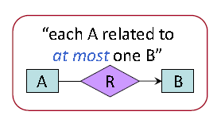
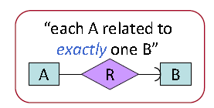
Basic Notation
Entity
Weak entity set
Relationship set
supporting
Relationship
Attribute
Multiplicity of relationships / Key Constraints
Referential integrity: (1) many-one or one-one (2) existence

Slide 6
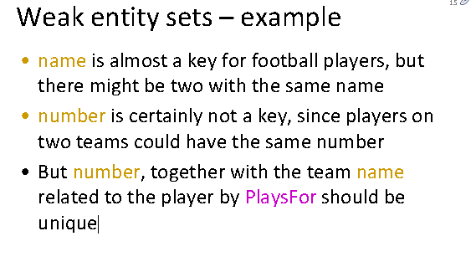
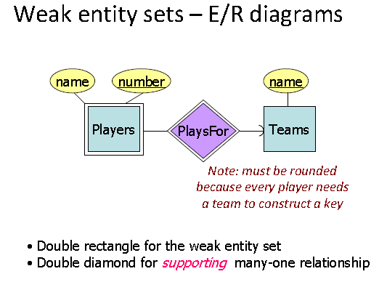

Slide 7
Basic Notation 2
Key Attribute
Multivalued Attribute
Differences between composite attribute?
R
E1
E2
Total Participation of E2 in R

Slide 8
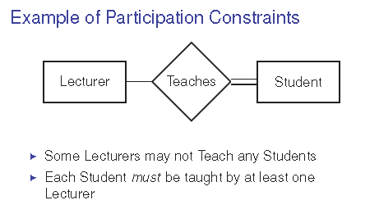

Slide 9
Basic Notation 3
1
R
N
E1
E2
Cardinality Ration 1:N for E1:E2 in R
(min,max)
R
E2
Cardinality Ration 1:N for E1:E2 in R
<=10
<=10 entities can be connected to any on entity of the related entity set

Slide 10
Multiplicity of Relationships
Many-many
Many-one
One-one
Representation of Many-One
E/R: arrow pointing to “one.”:
  Sharp arrow = “at most one”
  Rounded arrow = “exactly one”

Slide 11
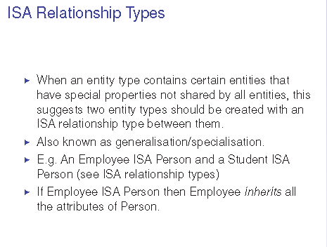
ISA Relationship Types
I When an entity type contains certain entities that
have special properties not shared by all entities, this
suggests two entity types should be created with an
ISA relationship type between them.
I Also known as generalisation/specialisation.
I E.g. An Employee ISA Person and a Student ISA
Person (see ISA relationship types)
I If Employee ISA Person then Employee inherits all
the attributes of Person.

Slide 12
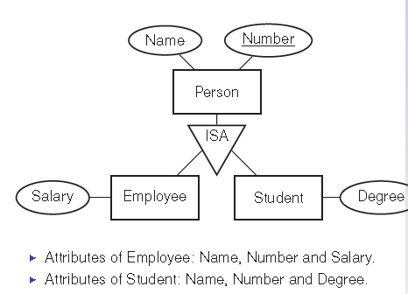
ISA example

Slide 13

Different Sets of Notations
Two different sets of ER notations are commonly used.
One from Ullman’s book as shown on the last slide
Another from Ramakrishnan’s book with main differences in:
- arrow always pointing to “relationship”;
- notations of partial or total participation constraints;
- notation of aggregations.
- for instance:

Slide 14
Exercise #1 - 1
A database for a bank includes information about customers and their accounts.
Information about customer includes name, address, phone, and social security number.
Accounts have numbers, type (saving, checking), and balances.
An account can be owned by several customers, and a customer can have multiple accounts.
Come up with a ER Diagram for the above info

Slide 15
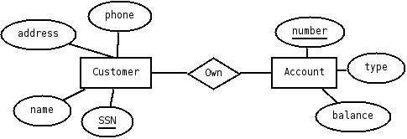
Exercise #1 - 2

Slide 16
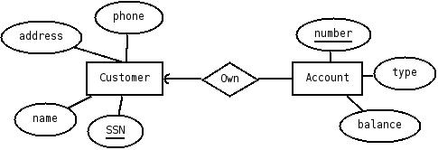
Exercise #2
Change your design so that an account can have exactly one customer

Slide 17

Exercise #3
Further change your design so a customer can have at most one account

Slide 18
Exercise #4 - 1
Change your original design so that a customer can have a set of addresses (street, city, state) and a set of phones.
Remember that we do not allow non-atomic types for attributes.

Slide 19
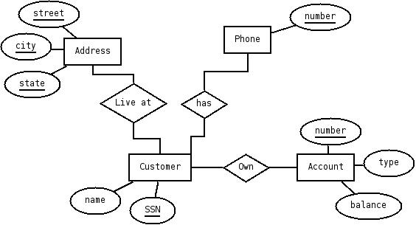
Exercise #4 - 2

Slide 20
Exercise #5 - 1
Further change your original design so that a customer can have a set of addresses. Also, at each address, there is a set of phones.

Slide 21
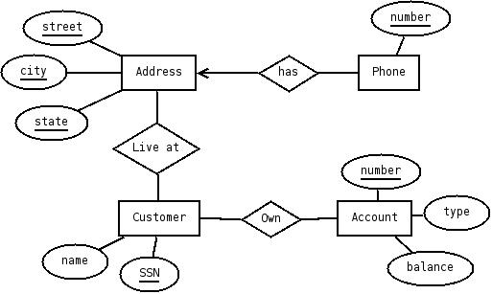
Exercise #5 - 2

Slide 22
Exercise #6 - 1
Design a database for a university registrar.
This database should include information about students, departments, professors, courses, which student are enrolled in which courses, which professors teach which courses, student grades, TA for the course (TAs are students), which courses a department offers, and any other information you deem appropriate.

Slide 23
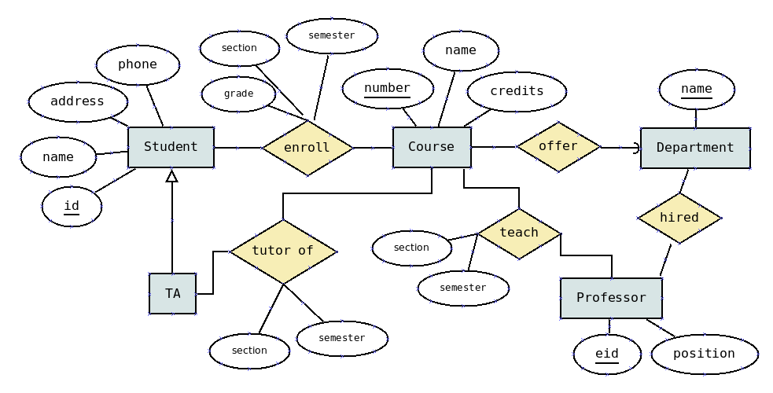
Exercise #6 – Solution #1
Is this a
good design?
OK, but not a good design. “semester” and “section” appear in several relationships -> Can’t guarantee the consistency of DB easily

Slide 24
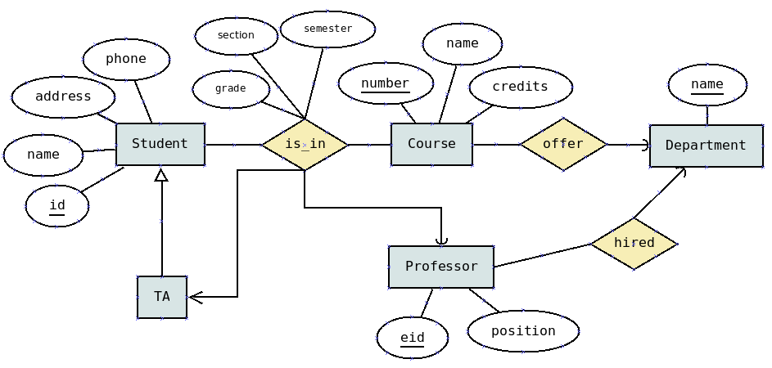
Exercise #6 – Solution #2
Is this a good design?
No. Lots of redundancy (in “is_in”),
although the E/R diagram itself looks simpler

Slide 25
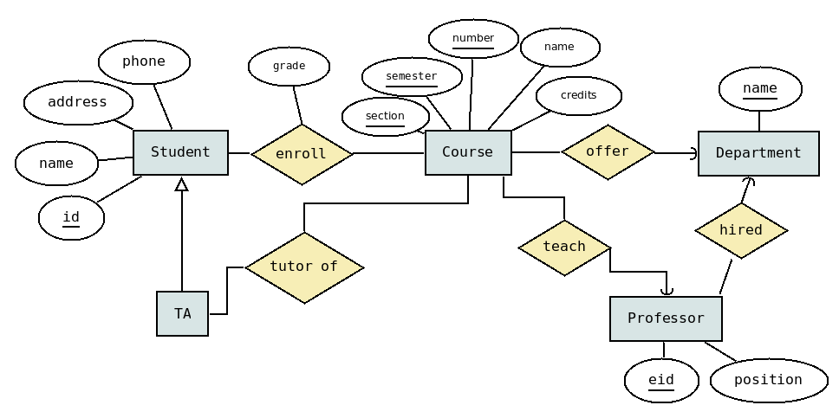
Exercise #6 – Solution #3
Is this a good design?
This solution has less redundancy comparing to the previous 2. But redundancy still exists in “Course”.

Slide 26
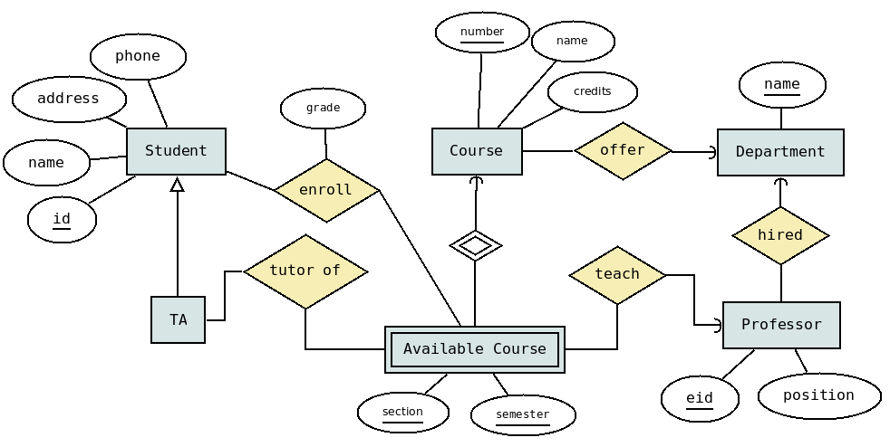
Exercise #6 – Solution #4
Is this a good design?
Yes!

Slide 27


ERD Notation
Entities, Relationships
Weak Entities and Relationships
The more you practice the better your ERD skills will be.
Multi-way Relationships

